Slide 1
Market Segmentation & Competition Tanguy Chau Energy 203 February 2nd 2017

Slide 2
Introduction
Tanguy Chau
Chemical Engineer
Entrepreneur
Venture Capital
UC Berkeley (BS) & MIT (MS, PhD)
Energy & Synthetic Biology
Accelergy (2004)
Novophage (2008)
Sample6 (2010)
Angeleno Group (2011)
Formation 8 (2014)

Slide 3
Agenda
Why is market segmentation important
How this applies to your startup
Targeting the right market
Appendix

Slide 4
What constitutes a market segment?
Collection of buyers and sellers that through their actual or potential interactions determine the price of a product or a set of product?
Examples
Industry
Real Estate
Your product
SFH in SF
Same market segment?
SFH in San Carlos?
Condo near Stanford?
Commercial RE in SF?

Slide 5
Why is this important?
Know who your actual & potential customers and competitors are
Misconception of the market versus reality
Impact public policy decisions
Allow / challenge M&A
Prioritize your efforts & own a segment
Find product market fit
1
2
3

Slide 6
Agenda
Why is market segmentation important
How this applies to your startup
Targeting the right market
Appendix

Slide 8
Steps to market segment analysis
Establish clear alternatives
Establish targeting & prioritization framework
Get buy-in on the framework; know how it will be applied
Obtain reliable data
1
2
3
4

Slide 9
Example: Your company sells voice response software for the Financial Services industry

Slide 10
Establish clear alternatives
1
Which verticals …which accounts?
100%
Retail Banking
~$180M / yr
Credit and Charge Cards
~$215M / yr
Market
Share
Mortgage Credit ~$25M / yrs
Retail Brokerage ~$40M / yr
Investment Services ~$35M / yr
Life Insurance / Diversified Financial Services ~$30M / yr
0%
34%
41%
5%
7%
7%
6%
0%
Industry Share
100%

Slide 11
Establish targeting and prioritization framework
2
• 13 carefully selected criteria based on win-loss analysis, customer interviews
• Thoughtful weighting is as important as the criteria
Retail Banking
Credit and Charge Cards
Mort.
Credit
Retail
Brok.
Inv.
Svcs
Life Ins. /
Div. FS
100%
Too Small (3%)
Too Small (4%)
Other
(9%)
Small
(9%)
Recent IVR
Purchase (39%)
Recent IVR
Purchase (15%)
Small
(9%)
Other Telecom Network (41%)
OTN
(10%)c
Too Small (46%)
Recent IVR Purchase (50%)
Market
Share
Other Telecom Network (42%)
Life Insurance / Diversified Financial Services (91%)
14%
OTN
(11%)
Credit and Charge
Card (40%)
Investment Services (73%)
RB
(17%)
OTN (36%)
Retail Banking (14%)
0%
34%
41%
5%
7%
7%
6%
0%
Criteria: (1) not captive to other telcom (2) did not buy IVR recently (3) big enough (4) other criteria
Industry Share
100%

Slide 12
This is who is really in your market
3
Retail Banking
Credit and Charge Cards
Retail
Brokerage
Investment
Services
Life Insurance /
Diversified Fin Svcs
100%
Company 1 (5%)
Company A (3%)
Com. AA (7%)
Company 11 (4%)
Company B (14%)
Company 12
(7%)
Company 2 (5%)
Company BB
(9%)
Company 13
(8%)
Company 3 (6%)
Company C (16%)
Company CC
(10%)
Company 4 (6%)
Com. #3
(17%)
Company 14
(10%)
Company 5 (10%)
Company
(11%)
Company 15
(11%)
Company D (16%)
Company 6 (13%)
Company #2
(17%)
Company
(18%)
Company 16
(14%)
Market
Share
Company E (22%)
Company 7
(35%)
Company AA
(45%)
Company 17
(18%)
Company F (30%)
Company 18
(30%)
Company #1 (50%)
0%
0%
Industry Share
100%

Slide 13
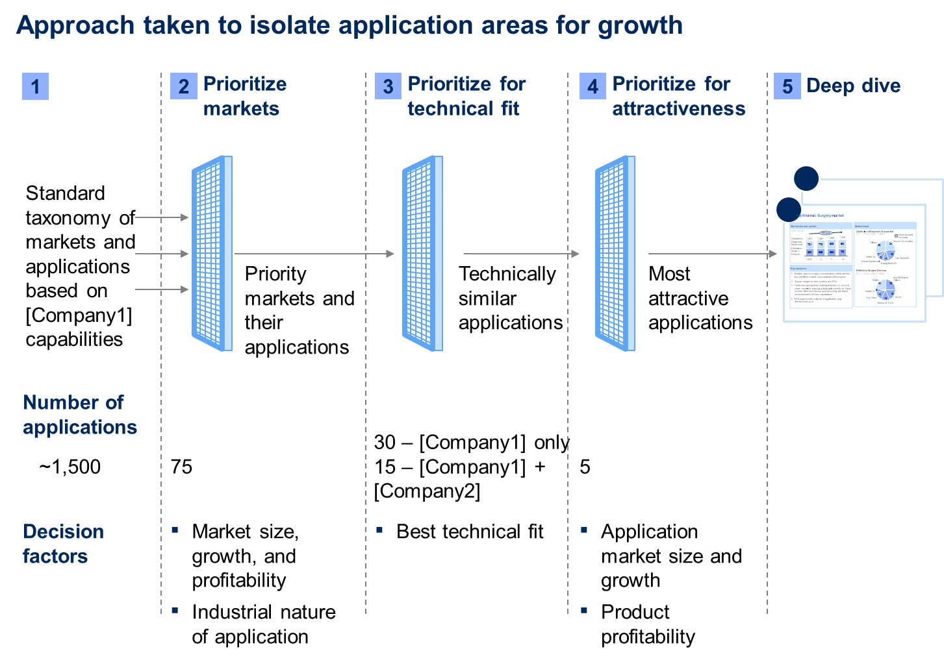
Example in practice

Slide 14
Result: market for a next gen. power converter

Slide 15
Agenda
Why is market segmentation important
How this applies to your startup
Targeting the right market
Appendix

Slide 16
Innovator’s dilemma
Clayton Christensen
1997
Competition is for losers
Peter Thiel
WSJ Sept 12, 2014

Slide 17
Capturing value
Target a market segment where you CREATE and CAPTURE a lot of value

Slide 18
Big piece of a small pie
All US airline carriers combined
2012 Revenue
$195B
$50B
2012 Profit margin
0.2%
21%
Market capitalization
$112B
$393B

Slide 19
Perfect competition vs. monopoly
Small perceived difference because companies are incentivized to lie about their position
A
A
B
B
Perfect competition
Monopoly
“we are in a narrow market of our own … at the intersection of different markets”
“we are in a huge market defined by the union of many separate markets”
→ Shrink their market to make it appear differentiated
→ Expand their market to make it appear more competitive
Examples:
LED companies
Solar technologies
Biofuels
Tesla
Google
Antitrust cases

Slide 20
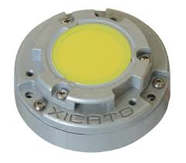
Narrative of competitive companies
Remote phosphor LED module
Higher “Quality of light”
Is the “Quality of light” a real market?
How big is it beyond possibly hospitality, museum and retail?
Is quality of light THE key attribute that consumer want and care about, or is it cost reduction?
Notes:
Talk about Xicato’s delusion of “Quality of light” market for museums, retail and hospitality

Slide 21
Narrative of differentiated companies
Small exclusive high-end electric car market
High price point with profits made (>$100k)
Attractiveness created brand ambassadors
Large highly competitive economy car market
Low price point far from profitable (~$30k)
Looked terrible, drove even worse
Notes:
Talk about why Tesla

Slide 22
Start slow: Focus and dominate a niche market first
Monopoly
Market competitiveness
Perfect Competition
Small
Big
Size of market segment
Find product market fit: win in a small segment where you can own the customer and make outsized profits before tackling the large competitive markets
Notes:
-- Go through the model

Slide 23
Recognizing a competitive market
Notes:
-- Discuss presentations from cleantech companies → We are in a trillion dollar market
-- The tell themselves their companies has a market differentiating edge, but the truly they are just “participant” in a highly competitive trillion dollar market where the customer doesn’t care about the “edge” the company think it has
-- This is best exemplified by a comment that the Dave Pearce, the MiaSole CEO made to the congressional panel in 2006
-- Where he predicted that MiaSole would become the largest producer of thin-film solar cells in the works within a year
-- but minutes later admitted that they were one of more than a dozen very strong companies persuing

Slide 24
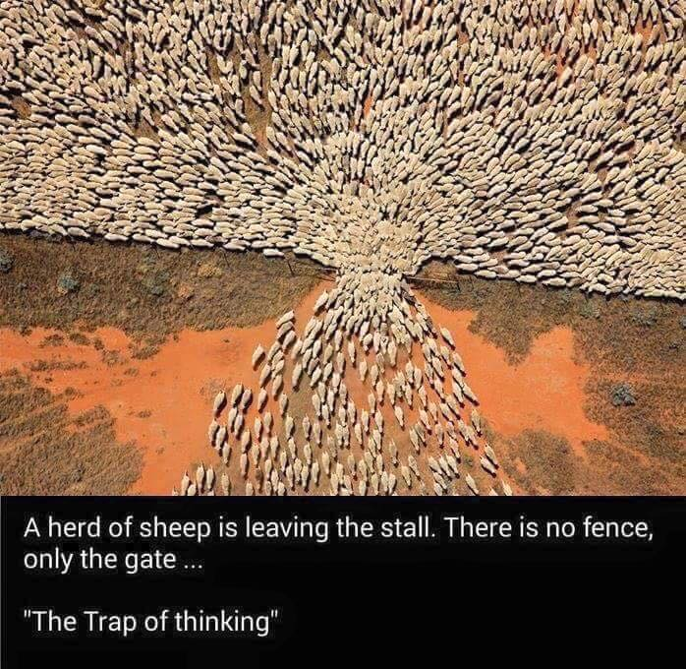
The trap of thinking
Notes:
About competition
We are trained to evaluate ourselves in comparison with other

Slide 25
Takeaway for Cleantech 2.0
The macro needs for energy solutions are real
Lingering aversion to invest in capital intensive and long timeline projects
Don’t be merely a market participant, be the dominant player
Vision might be big but focus and dominate a niche market first

Slide 26
Agenda
Why is market segmentation important
How this applies to your startup
Targeting the right market
Appendix

Slide 27
Market segmentation for semi. equipment manufacturer (1/8)

Slide 28
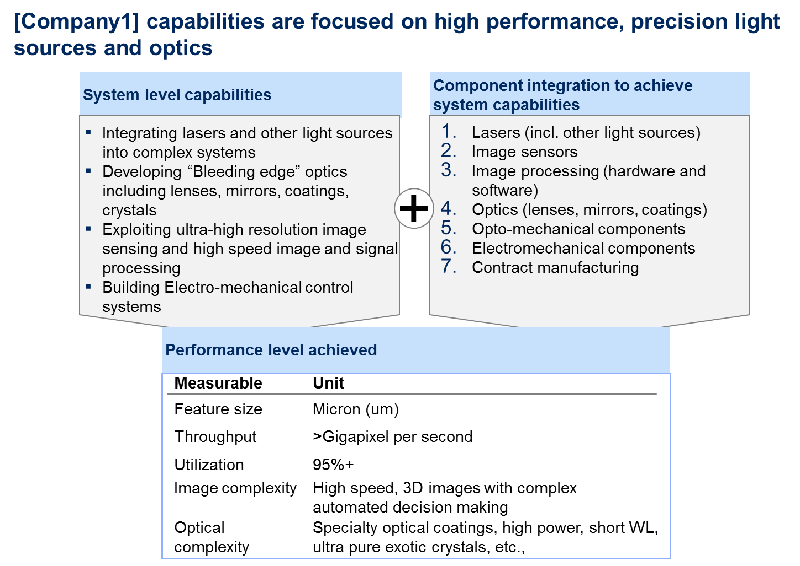
Market segmentation for semi. equipment manufacturer (2/8)

Slide 29
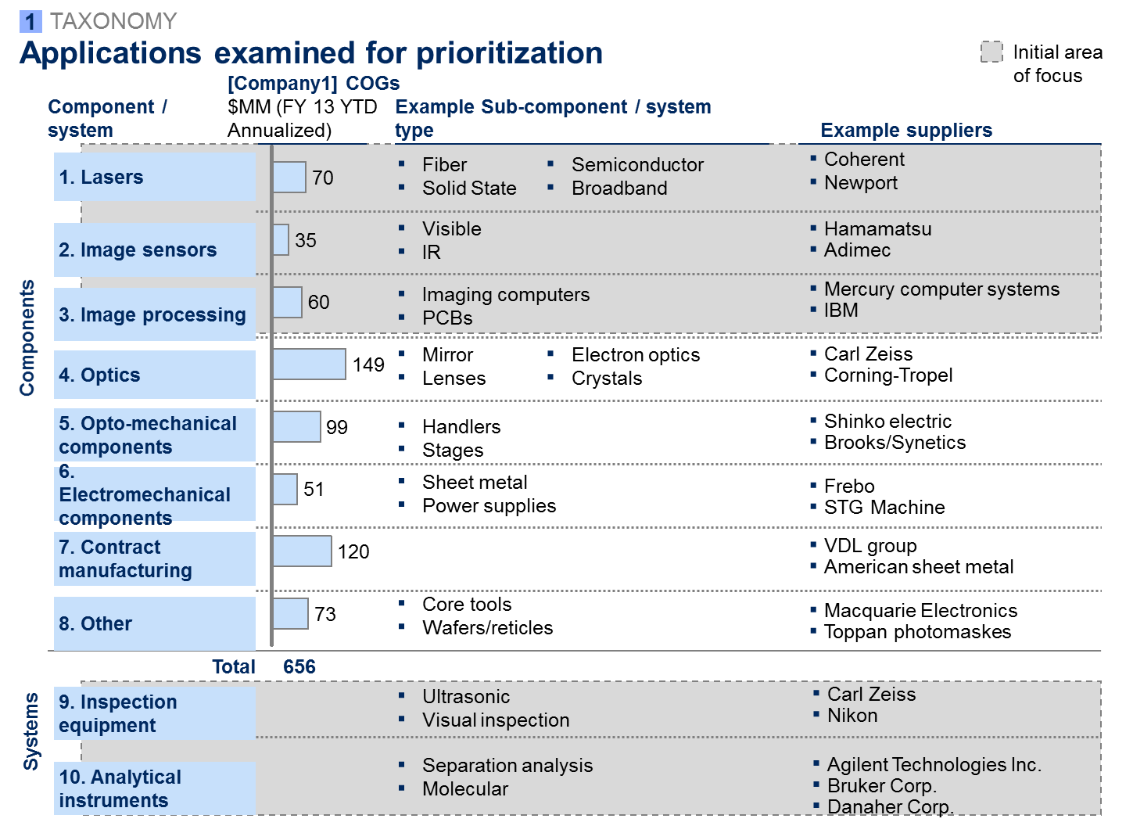
Market segmentation for semi. equipment manufacturer (3/8)

Slide 30
Market segmentation for semi. equipment manufacturer (4/8)

Slide 31
Market segmentation for semi. equipment manufacturer (5/8)
…Repeat the last slide for technical fit analysis for other segments (i.e. inspection and analytical instruments)…

Slide 32
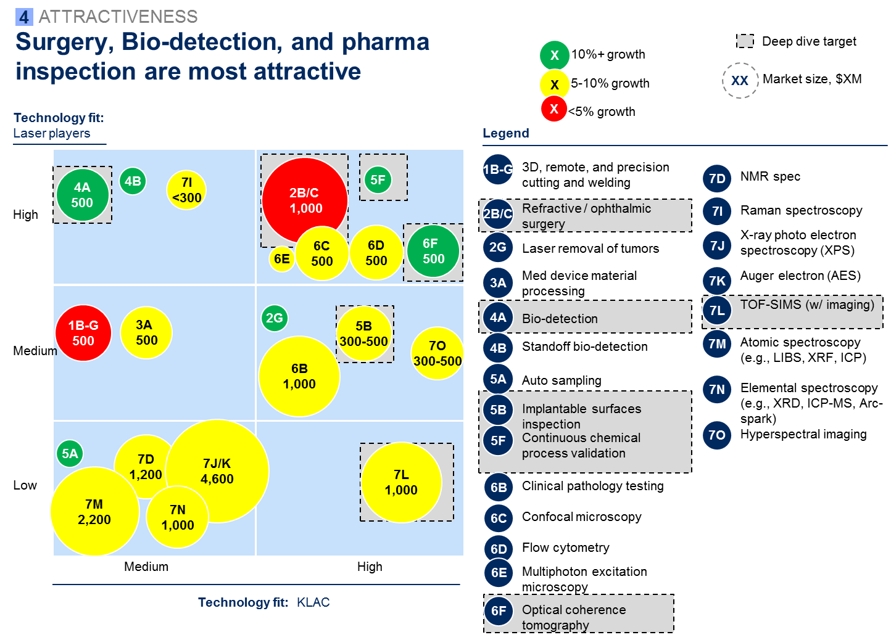
Market segmentation for semi. equipment manufacturer (6/8)

Slide 33
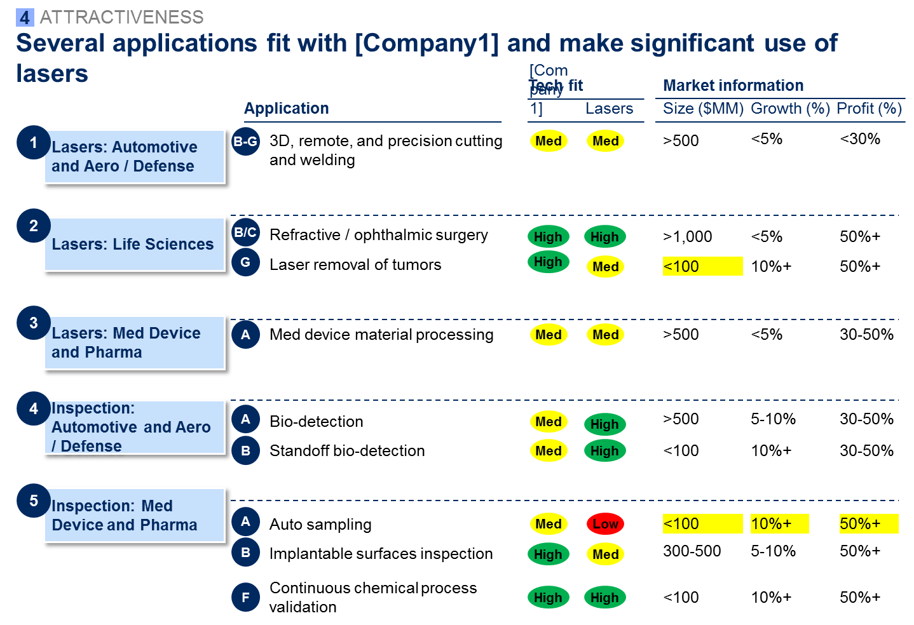
Market segmentation for semi. equipment manufacturer (7/8)

Slide 34
Market segmentation for semi. equipment manufacturer (8/8)

